Slide 1

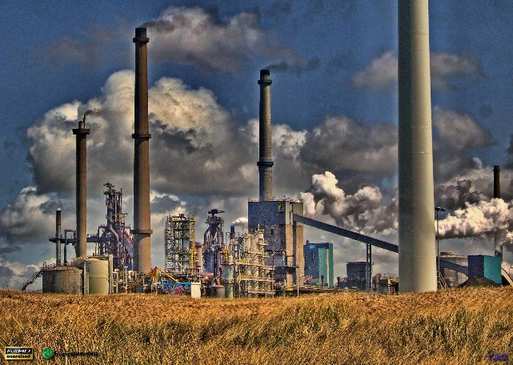
Engineering Safety and Risk Management Program
ENGG404 – Seminar #1 of 6
Team Project Assignment
ESRM - ENGG404 LRM
1
Notes:
ENGG404 Lecture 00 - Day 1
2012 Fall
1
1

Slide 2
Seminar: Team project
Today:
Sit in your teams!
Team project introduction – progress report
Team project selection
Work on incident description & losses
Work on context & purpose
In the Team Project Instruction Manual (not the Handbook!)

Slide 3
Seminar: Team project
Important:
It is your responsibility to read these modules and the course plan and be aware of deadlines.
The team project is meant for you to apply some of the tools presented in this course. This will imply some repetition (e.g. incident description for the report, the Root Cause Analysis and the Cause and Effect Model). No need to reword these.
Your team will evaluate your contribution.
It is an industry report, not a scholar report

Slide 4
Seminar: Team project
Project:
Imagine your team is working for “The ABC Conglomerate Company”. Senior management within ABC has learned of an external loss incident (the loss incident you selected). Because ABC has an operation that is the same in all respects to the company that suffered the external loss incident, ABC senior management has requested you and your team to conduct an incident investigation and root cause analysis of the external loss incident, and to make recommendations. This is pro-active management because ABC management has recognized their operations are the same as the other company. ABC management wants to learn from others and does not want a similar event to happen within their operations; thus ABC management wants to make changes (based on your team’s recommendations) to their operations in order to prevent such a loss incident from happening at ABC.
To this end, you will work a Root Cause Analysis (with the aid of the Cause and Effect Model) to provide recommendations for enhancing safety. Although recommendations can be made for immediate, basic and latent causes, we will put emphasis in the latent causes, and how these reflect weaknesses in the elements of the Risk Management System.

Slide 5
Seminar: Team project
Project:
The team project consists of two parts, as follows:
Team project progress report
Team project final technical report
Project Marks:
Progress Report = 5%
Final Technical Report = 10%
Total Team Project Mark = 15%
Team Project Seminar #1 of 6

Slide 6
Seminar: Team project
Project:
Research an actual loss incident (case study) which has occurred since 2000 (i.e. nothing prior to 2000). Your case study does not need to be an event that grabbed world headlines. The case study must be such that it has caused losses in at least three of the following areas:
Worker Safety and Occupational Health
People (the general public) Safety
Environmental Damage
Asset Loss
Production / Productivity Loss / Business Interruption
The case study should be a “major loss incident” relevant to your engineering discipline
Exclusions are listed on eclass – you CANNOT use these case studies
Your team project choice must be approved by your instructor prior to proceeding

Slide 7
Seminar: Team project
Project:
COVER PAGE
The Cover Page per the details in the posted template.
TABLE OF CONTENTS
The table is generated using the embedded TOC in the posted template.
EXECUTIVE SUMMARY
Incident Description and Losses:
Context and Purpose:
Root Cause Analysis:
List of Latent Causes:
REPORT CHAPTERS:
Chapter 1: Incident Description and Losses:
Chapter 2: Context and Purpose:
Chapter 3: Root Cause Analysis – Discussion:
Chapter 4: Application of the Cause and Effect Model – Discussion:
References:
Appendix A: Root Cause Analysis – Chart:
The total number of pages of the report is in the order of 10 to 20 pages, perhaps somewhat more:
One (1) page for the Cover Page; and 1 page for the TOC if not included on the Cover Page;
Two (2) pages maximum for the Executive Summary. A penalty will apply for exceeding 2 pages!
As many pages as you deem necessary in the chapters.

Slide 8
Seminar: Team project
Today:
Select your team project incident
Start work on:
Incident Description & Losses
Context & Purpose
In the Team Project Instruction Manual (not the Handbook!)
Team Project Seminar #1 of 8

